Slide 1


Unit 3 Welcome to Sunshine Town!
Revision

Slide 2


How can we welcome friends?

Slide 3

an old friend of mine
is coming
An old friend of Eddie’ s _________ come to see him, but there is _________ in the fridge. He is going to the _________. Just then Hobo tells him to _________ a minute because they only have five yuan, and it’s not _________ for a tin of dog food. Eddie wants to __________ a pizza at last. Do you think it is possible?
will
nothing
there isn' t anything
supermarket
wait
enough
order
be enough for/to buy sth.
have enough money for/to buy sth.

Slide 4
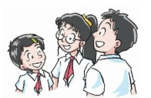
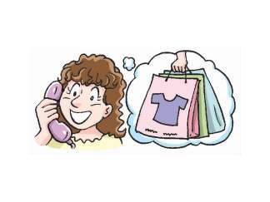
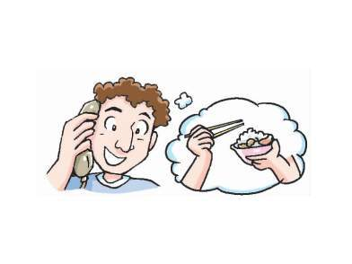


How can we welcome the exchange students?
[ɪksˈtʃeɪndʒ]
A group of exchange students from the UK are coming to visit Sunshine Town.
Where can the students take them?

Slide 5
take them to the cinema
Expressions to make suggestions(建议):
Let sb. do ….
I’d like to do …
What/ How about doing …?
Shall we do …?
Why not/ Why don’t you do …?
Maybe you can do ….
take them to the shopping mall
take the boys to the school' s football field
take them to different restaurants
…

Slide 6
There are lots of things to do in Sunshine Town.
There are lots of places to visit in Sunshine Town.
What else can they do in Sunshine Town?
The Class 1, Grade 7 students are planning some more activities in Sunshine Town for the exchange students.

Slide 7
Notes about Sunshine Town
Welcome to Sunshine Town!
Location
center
not _______ from the _______ of Beijing
far
fresh
enjoy _______ air and see many trees, lakes and green hills
Stay in a _______ town
quiet
jogging
go _______ in the park in the morning
presents
buy wonderful _______ for family and friends
Go shopping
buy family and friends wonderful presents
Chinese
famous
try _______ food, such as _______ Beijing duck
Eat Chinese food
Western
go to _______ restaurants
Enjoy Beijing _______
opera
visit the _______ theatre
local

Slide 8
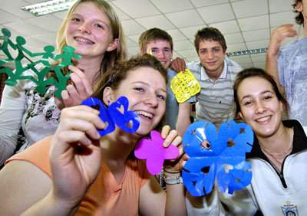
How can we get to the center of Beijing?
You can go to the center of Beijing by underground.
You can go to the center of Beijing on the underground.
You can take the underground to the center of Beijing.
How long does it take us to get to the center of Beijing?
It takes you 40 minutes to get to the center of Beijing.
It takes sb. some time to do sth.
How far is it from the center of Beijing?
It takes 40 minutes by underground.

Slide 9
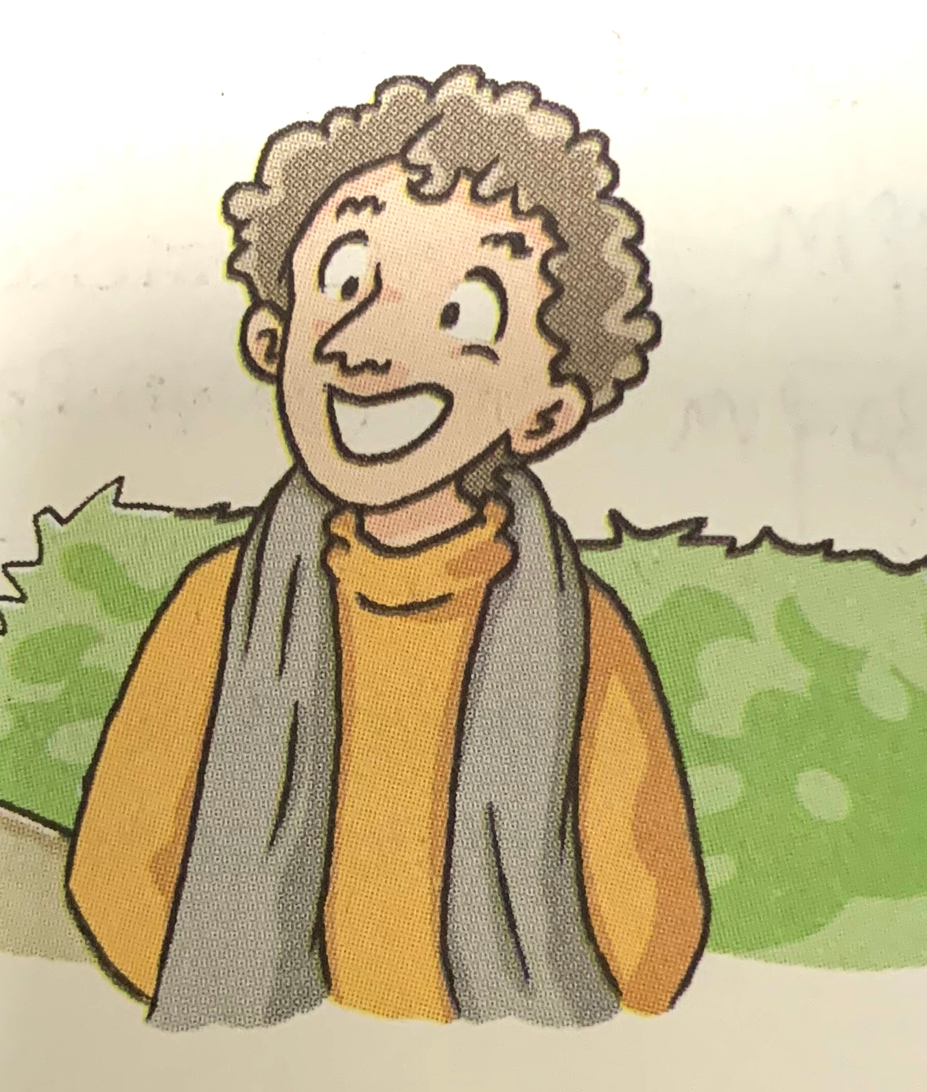
Neil, one of the exchange students, is interested in Chinese culture.
The opera shows help him learn more about Chinese art.
Where can he
learn about China’s history
in Beijing
?

Slide 10
Beihai Park
the Great Wall
the Summer Palace
the Palace Museum
Tian’anmen Square
There are many famous places _________ (learn) about China’s history.
to learn
We are looking forward __________ (visit) the Palace Museum.
to visiting
look forward to doing sth.

Slide 11
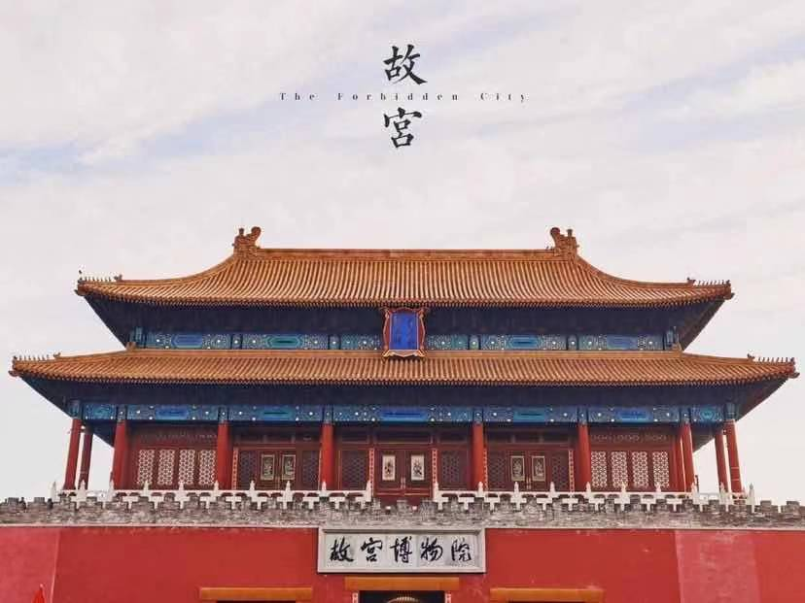
The Palace Museum is famous _____(for/as) a museum with a long history.
as
be famous as 作为…而成名
for
It is famous _____ (for/as) many works of art.
be famous for 因为…而成名

Slide 12
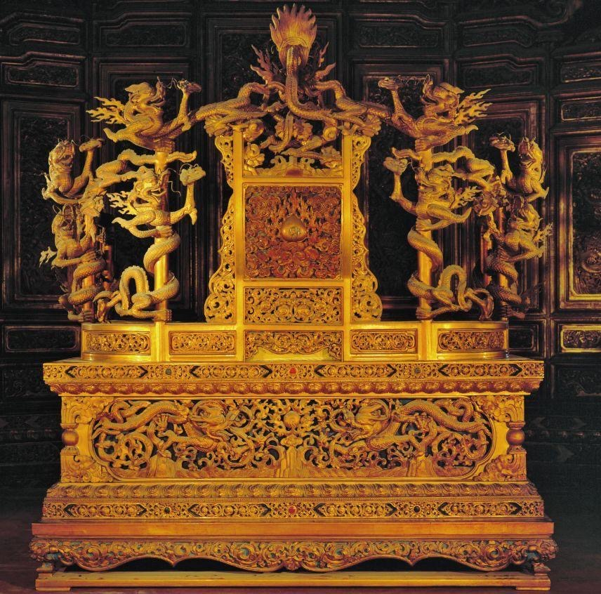
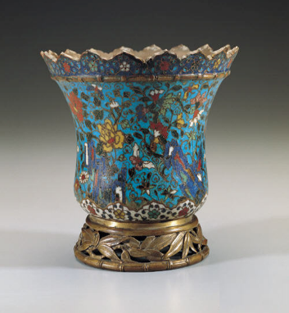

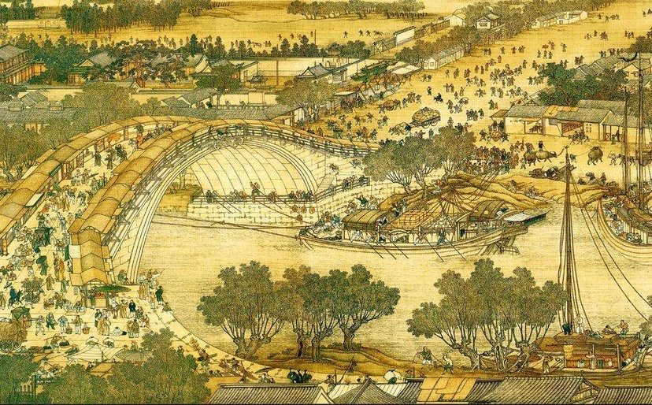
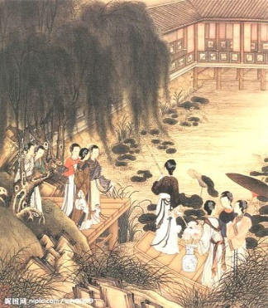
A show is on at the Palace Museum.
There are many things to see here! Don’t miss them!
We can learn all about China’ s history at the Palace Museum!
the golden throne
works of art
Chinese paintings
... and many more

Slide 13
The students have some presents for the exchange students, but their things got mixed up.
Noun + ’s
(名词所有格)
Kitty: Are those ________(you) postcards, Amy?
Amy: No, they aren' t ________(I). They are ________(Sandy).
Daniel: Are these hair clips ________(you)?
Millie: No, they are those ________(girl).
Simon: Whose caps are those?
Amy: They are the ________(children) caps.
Millie: Are these pencil cases ________(Tommy)?
Kitty: No. _______(he) are next to ________(I) pencil case.
your
Sandy’s
mine
yours
girls’
Possessive adjectives and pronouns
(形容词性和名词性物主代词)
children’s
Tommy’s
His
my

Slide 14
Noun + ’s
(名词所有格)
rules
在名字后面加 ’s
Sandy’s
在单数名词后面加 ’s
girl’s
以s结尾的复数名词后面加 ’
girls’
不以s结尾的名词复数后面加 ’s
children’s
表示两人共有，在第二个人后面加 ’s
Kitty and Millie’s
Kitty shares a pen with Millie.
表示两人分别所有，分别加 ’s
Kitty' s and Millie’s
Kitty and Millie have their own pens.

Slide 15
主格 | 形容词性物主代词 | 名词性物主代词
I
you
he
she
it
we
you
they
Possessive adjectives and pronouns
(形容词性和名词性物主代词)
my
mine
your
yours
his
his
her
hers
its
its
our
ours
your
yours
their
theirs

Slide 16
Possessive adjectives and pronouns
(形容词性和名词性物主代词)
This is Daniel’s book.
This is _______ book.
This book is _______.
a possessive adjective
his
his
a possessive pronoun
1. We need to put a noun after a possessive adjective, but we do not need to add anything after a possessive pronoun.
形容词性物主代词后面接名词,名词性物主代词后面不 接名词。
2. a possessive pronoun = a possessive adjective + noun
名词性物主代词相当于“形容词性物主代词+名词”。

Slide 17
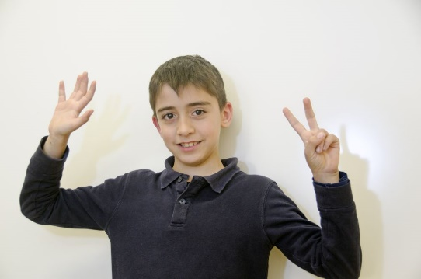
Sunshine Town is a good place to live.
John, one of the exchange students, also wants to introduce his hometown.
What is his hometown like?

Slide 18
farm
on a ______
Introduction
his house
two
has ______ floors
around
John’s house
trees and flowers ______
near
______ a lake
smell
______ the flowers
things to do
sing
hear the birds ______
John’ s hometown
row
main
body
______ a boat on the lake
know
______ each other
people
friendly
be ______ to each other
raise
John’s town
some families ______ cows, and others ______ wheat
grow
buses
traffic
______ to the town center
drive
______ to do the shopping
conclusion

Slide 19
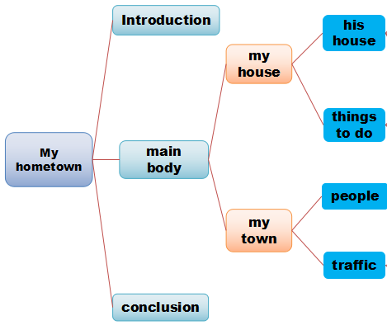
It' s time to introduce your hometown!
My hometown
...
My house
...
Things to do
...
Write down some notes.
Make an outline.
Useful expressions
*It has…
*There is/are….
*I like….
*Some…, and
others....
*It’s a wonderful…
How do we write about our hometown?
Write an article with
useful expressions.

Slide 20
Sample writing
Hello, I am Charlie from Class 2, Grade 7. I live in a flat in a tall building. Most people in my hometown live in buildings like this. My flat is on the ground floor and I have a garden in front of it. It’s great! I grow flowers in the garden and I often water them.
There are many buses to different places from my flat. At the weekend, my family visit friends by underground.
In my hometown, the zoo is my favourite place. I like watching the animals’ shows there. There are also some wonderful restaurants in my hometown. You can eat food from different countries there.
We enjoy our life there. I hope you can come and visit us soon. I am sure you will love it!

Slide 21
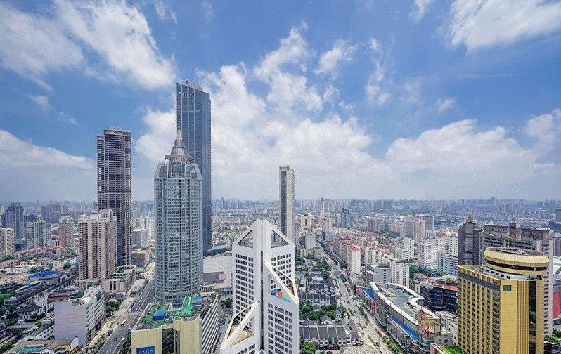

East or West, home is the best.
As a host, we should make friends feel at home.

Slide 22
Homework
Required to:
Make a review of Unit 3 and complete the exercises on the Task Paper.
Choose to:
Write an article about your hometown.

Slide 23
Thank you!

Slide 24
教材分析：
本单元是译林版教材七年级下册的第三单元，包括七个板块的内容（Welcome to the unit/ Reading/ Grammar/ Integrated skills/ Study skills/ Task/ Self-assessment），这一单元的七个大部分基本上都围绕着英国的一群交换留学生来参观阳光镇，阳光中学七年级一班的学生在积极计划一些活动而展开，语言知识和语言技能都是依据这一中心话题而设计的。

Slide 25
教学目标：
1.列举城市中的各种游览活动；
2.掌握有关城市中的生活方式和活动的词汇；
3.结合所学，运用已学的主要词汇介绍自己的家乡；
4.掌握名词所有格的用法，学会运用名词性物主代词和形容词性物主代词；
5.学会待客之道，与交换生和睦相处，能够邀请他人进行某种活动，以增进相互之间的友谊，并且坚定文化自信，学会欣赏自己的家乡之美，从而更好地促进跨文化意识。

Slide 26
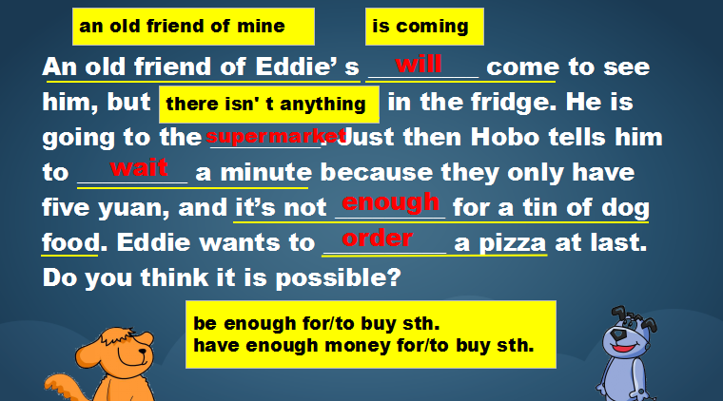
借助根据Comic strip概括的文本，导入话题，以及渗透语言点的复习。

Slide 27
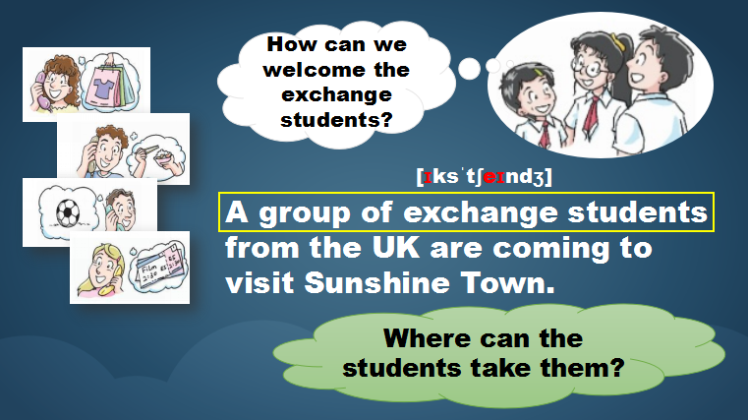
创设情境——英国交换生来参观阳光镇，中国学生正在讨论如何招待他们。

Slide 28
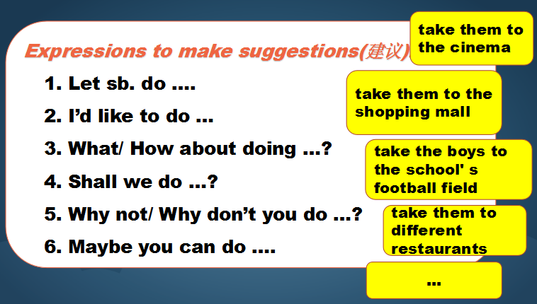
巩固Welcome to the unit板块中表建议的句型以及城市中的各种游览活动和如何接待友人的表达方式，结合句型和表达方式强化操练。

Slide 29
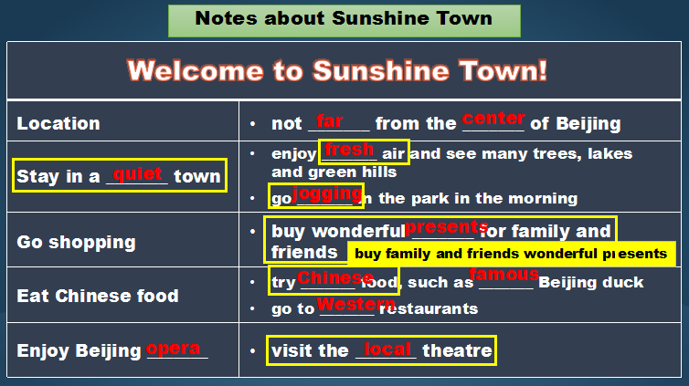
借助表格，巩固Reading板块中阳光镇的地理位置、环境、休闲活动等基本情况，以此巩固相关词组和语言点。

Slide 30
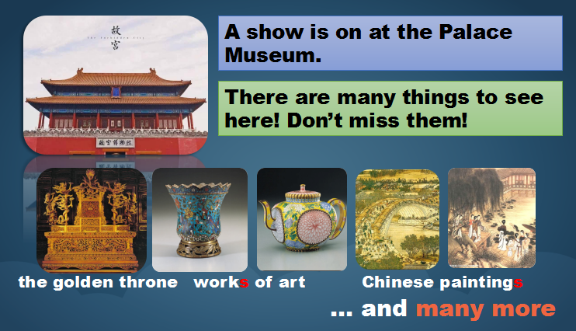
巩固Integrated skills板块中有关故宫的信息，掌握相关词汇。

Slide 31
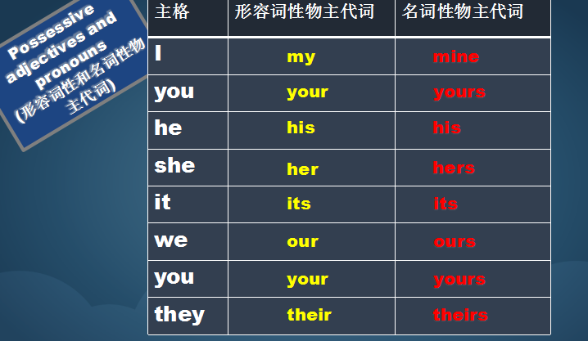
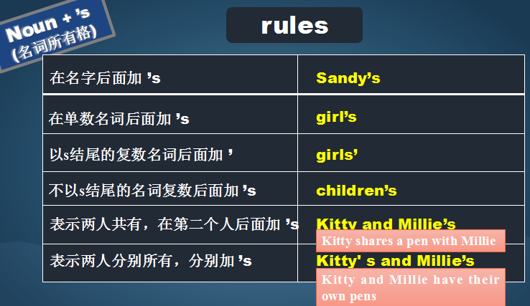
借助表格，归纳、整理Grammar板块中名词所有格的用法，巩固名词性物主代词和形容词性物主代词的用法和区别。

Slide 32
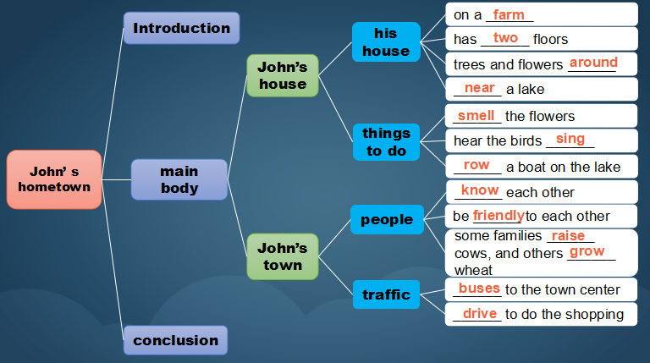
借助结构图，巩固Task板块中John介绍自己家乡的文本，并帮助学生理清写作思路，明确写作结构。

Slide 33
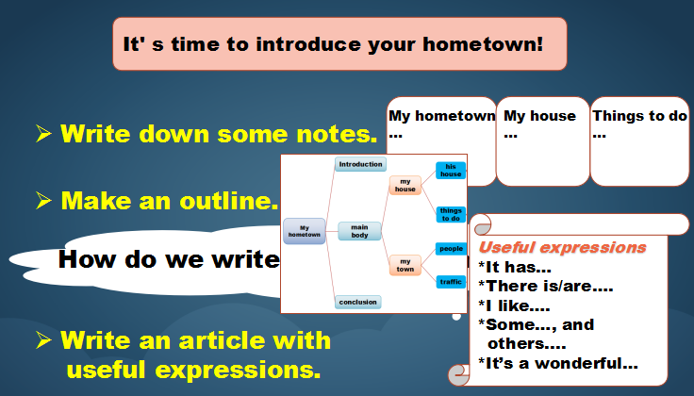
指导写作方法，提供清晰步骤，引导学生内化知识，结合所学，解决实际问题，写一篇关于自己家乡的文本，从而顺利完成本单元的最终任务。

Slide 34
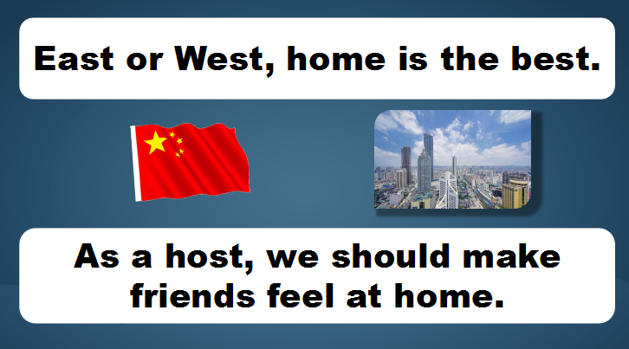
借助两句谚语，道出本单元的主题，即学会待外客之道，并坚定文化自信，学会欣赏自己的家乡，从而实现情感教育，帮助学生学以成人。

Slide 35
Thank you!

